Slide 1
RECYCLING PROGRAM
31st CES/CEI
Installation Management Office
Community Recycling Liaison

Slide 2
RECYCLING PROGRAM
WELCOME TO AVIANO!
Do you know how our recycling program works?
Do you know the Italian Environmental Law and Community Disposition work?
Simple! Once you rent your house contact 31 CES/CEI –Giovanna Coppola, Community Recycling Liaison at DSN 632-2511 and/or send an email to giovanna.coppola.it@us.af.mil
It is important to have immediately the right information to perform a properly and correct refuse separation collection to be a good neighbor!

Slide 3
AVIANO AB
COMMUNITY RECYCLING PROGRAM
AVIANO AIR BASE INSTRUCTION 90-502 14 DECEMBER 2009
Special Management
AVIANO AIR BASE COMMUNIITY STANDARDS
Paragraph 26.4 – Trash and Recycling in the community.
RECYCLING—DO YOUR PART
In Italy, recycling is required by law and not complying may result in fines. Additionally, bringing waste on Base for disposal is against the law. Every community in the local area has an Ecological Platform (EP)/Waste Collection Center (WCC). The rules vary by community, but they exist to help dispose of bulk items. These Eps won’t allow unsorted trash to be dropped off. Plan ahead to get rid of smaller items in an incremental and systematic manner.
For more information or questions, contact the Community Recycling Liaison, Giovanna Coppola at DSN 632-2511

Slide 4
COMMUNICATIONS
Aviano AB established a dedicated position as the intermediary between Local Authorities & base personnel for all off-base recycling issues, because communication is the key to success
Examples of duties:
Community Briefings
Cooperation with Local Communities and Contractors
Aviano Recycling Website
Coordinates bulky item pick-up w/ communities and contractors
Processes Ecological Platform Badges
Coordinates Ecological Days with Local Communities and Aviano AB/31FW
Responds to community complaints and notifications received from Local Police (recycling related)
Develops information packages for newcomers
Contact Info:
Ms. Giovanna Coppola
Community Recycling Liaison
0434-302511
giovanna.coppola.it@us.af.mil

Slide 5
ACTION
Aviano AB has identified issues contributing to program struggles and has taken the following actions:
Increased newcomer training in “Right Start” and/or “Info Fair”
Downloading “Community-specifics” recycling refuse calendars on our Recycling webpage https://www.aviano.af.mil/Site-Pages/Recycling/
Escalated awareness campaign through Wyvern, AFN Radio and Television, etc.
Being able to control and manage the problems of waste abandonment in order to reduce the numerous number of notifications that we receive from the Local Police Commands of the Province of Pordenone.

Slide 6
LEAVING AVIANO? NEED TO DISPOSE OF BULKY ITEMS?
Contact the Community Liaison at 632-2511 for assistance
BULKY ITEMS PICKUP AND ECOLOGICAL PLATFORMS (EPs)
Off-base ecological platforms (EPs) are fully operational.
EPs will not allow the disposal of unsorted trash to be dropped off. Plan ahead to get rid of smaller items in systematic manner. Waste must be separated and no mixed!
To schedule an appointment for bulky items home pick-up service send an email to Giovanna Coppola giovanna.coppola.it@us.af.mil (31 CES/CEI community recycling liaison)
Email must include:
Full name and address of the requester, including the cell phone number;
Landlord/Landlady info and contact information, including the cell phone number;
Detailed list of items that needs to rid of;
Service does not include the pick-up of non-recyclable dry waste, organic waste and used clothes.

Slide 7
LEAVING AVIANO? NEED TO DISPOSE OF BULKY ITEMS?
Contact the Community Liaison at 632-2511 for assistance
BULKY ITEMS PICKUP AND ECOLOGICAL PLATFORMS (EPs)
*Important notice: service must be requested only by email and at least three weeks in advance, precisely because the service is addressed to all users of the Municipality and not only for American users! Service is on payment and the costs vary from municipality to municipality and from the waste management company. Costs of service can vary according to the quantity of bulky items to picked up (from a minimum of 60 euros to a maximum and more than 200 euros). Therefore, we invite the users to personally bring waste at the EP of residence because is free of charge.

Slide 8
ECOLOGICAL PLATFORM PROCEDURES AND ACCESS
To have access to the ecological platforms, it is necessary to have an
identity card and a copy of the first page of the rental contract –this is the
proof that the users resides in that municipality--.
Access to EPs of Pordenone, Cordenons, Roveredo in Piano and San Quirino is allowed only with the badge issued by GEA, while for Budoia users must go to Budoia environmental office-rental contract is required-. For assistance contact Giovanna at DSN 632-2511 or send her an email giovanna.coppola.it@us.af.mil .
For what above indicated it is mandatory to contact the own landlord/landlady and ask him/her to provide the tenant with the badge.
It is understood that for any inconvenience, support and assistance users should contact Giovanna 31 CES/CEI Community Recycling Liaison.

Slide 9
WHAT ARE BULKY ITEMS?
Bulky items are: furniture, outdoor furniture (like plastic and wood), plastic, cardboard, electrical and electronic household appliances, toys, mirrors and etc. A full list of items that can be brought to the Eps and that are allowed for bulky items home pickup service are posted on our recycling webpage https://www.aviano.af.mil/Site-Pages/Recycling/ and list of items can be read on the refuse calendars of the communities posted on the webpage.

Slide 10
PCS RECYCLING GUIDANCE
There are many things to do on your PCS out of Aviano. Discarding unwanted
items during the “PCS Purge” can be a simple process if done early and correctly.
During your time in Italy you collect new things, but you also outgrown others.
Some things can be sold or donated, but everything that needs to be thrown out
must be done correctly. Every community in the local area has an Ecological
Platform, the Italian equivalent of the city dump. The rules for use vary by
community, but they do exist and you need to use them for bulky items. They
don’t allow you to drop off bags of unsorted trash. You can get rid of smaller
excess items in an incremental/systematic manner through your normal “mixed
waste” trash can. If you have a lot to get rid of this may take months. If you wait
until the last week, you can expect to have to pay for excess waste
removal. Remember, you cannot bring your waste to base. Likewise, if you dump
your trash off base you are breaking the law and will be fined. Plan ahead for a
smooth PCS. Don’t wait until you have orders to do the “PCS Purge” - make it a
seasonal habit.

Slide 11
COMMUNITY GUIDES TO RECYCLING
Refuse Calendars posted on the recycling webpage are in Italian and English version.
Click the town name to view specific recycling guidelines.
Click the “current year refuse calendar” link beside your community name to download the current year community refuse calendar.
A “current year refuse calendar” link will appear as new calendars are added for each community
Refuse Calendars include January and February of the next year; so be sure to scroll to the end of the pdf to check its end month.
If you cannot find your town, press ctrl+F and search the page as some towns fall under a parent community.

Slide 12
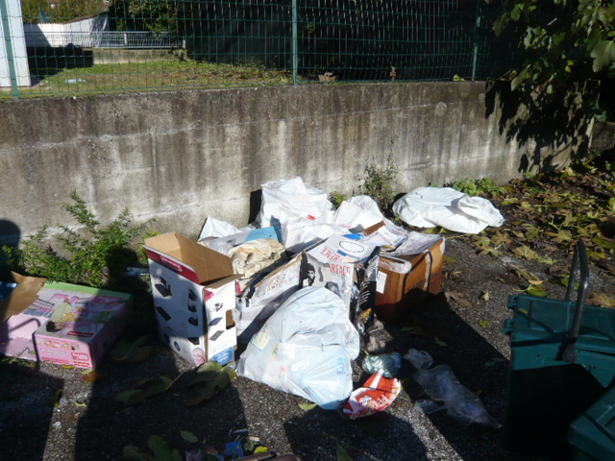
Some photos of waste abandoned in Province of Pordenone territory. DO WE LIKE IT???

Slide 13
